Slide 1
CROSS LAYER TRACING IN KUBERNETES
Runzhou Han
Aditya Chechani
Reet Chowdhary
Taiga: https://tree.taiga.io/project/msdisme-2018-bucs528-template-7/
GitHub: https://github.com/BU-NU-CLOUD-SP18/Cross-Layer-Tracing-in-Kubernetes

Slide 2
Tasks Completed
Install Kubernetes on local cluster
We were not able to do this on the MOC after spending 6+ hours on it with our mentor
Write a Node.js application, containerize it, deploy it in Minikube and write an ingress to expose it to external traffic
Install nginx on one of the local machines
Use nginx to set up proxy server routed to two separate flask apps
Find section of nginx source code pertaining to manipulation of HTTP headers

Slide 3
Ingress and Nginx
An Ingress is a Kubernetes resource that lets you configure an HTTP load balancer for your Kubernetes services.
The load balancer exposes your services to clients outside of your Kubernetes cluster.
Could be done by a custom URL (Service A at /serviceA and Service B at /serviceB)
Could be done by multiple hostnames (serviceA.example.com or serviceB.example.com)

Slide 4
Our findings on looking at Nginx and Kubernetes source code
Nginx can be used as a load balancer
Requests come in from the outside world and nginx routes the requests to the services inside the cluster
The ingress controller looks at the available ingress resources using the Kubernetes API and makes changes to the configuration of the load balancer (nginx in this case)

Slide 5
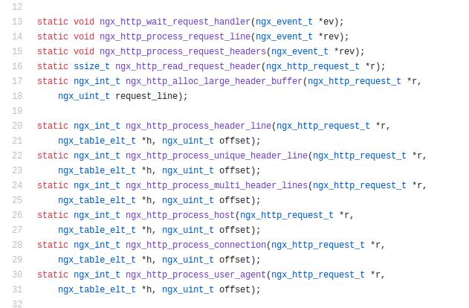
Nginx source code

Slide 6
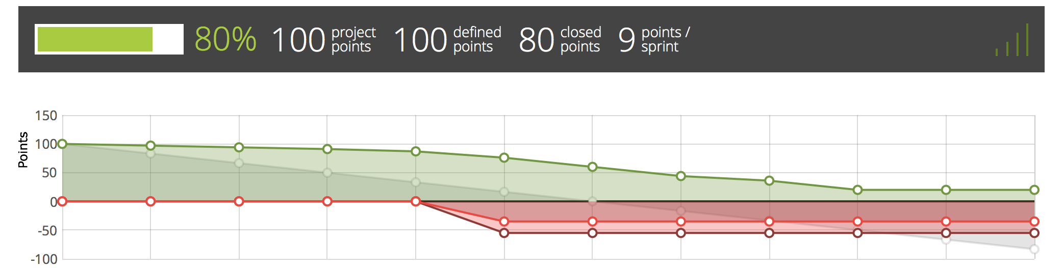
Taiga burndown chart

Slide 7
Next steps
Install Nginx from source and set it up with our two applications as backend.
Add some logs to the part of source code we think are responsible for header manipulation.
Figure out exactly where the header manipulation is being done.
Add trace points to these parts and make a docker image of our customized Nginx(This is because when building kubernetes from source it pulls the image of Nginx from docker and builds it)

